Slide 1
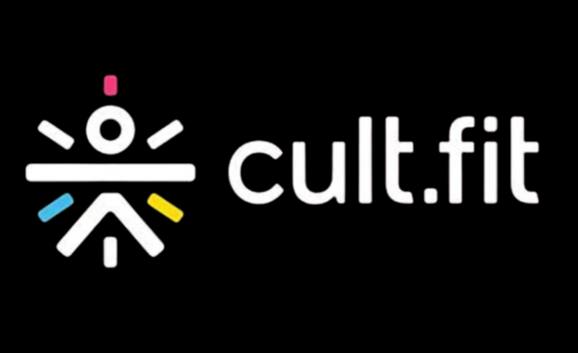

A 4PS MARKETING ANALYSIS & STRATEGIC REPOSITIONING

Slide 2
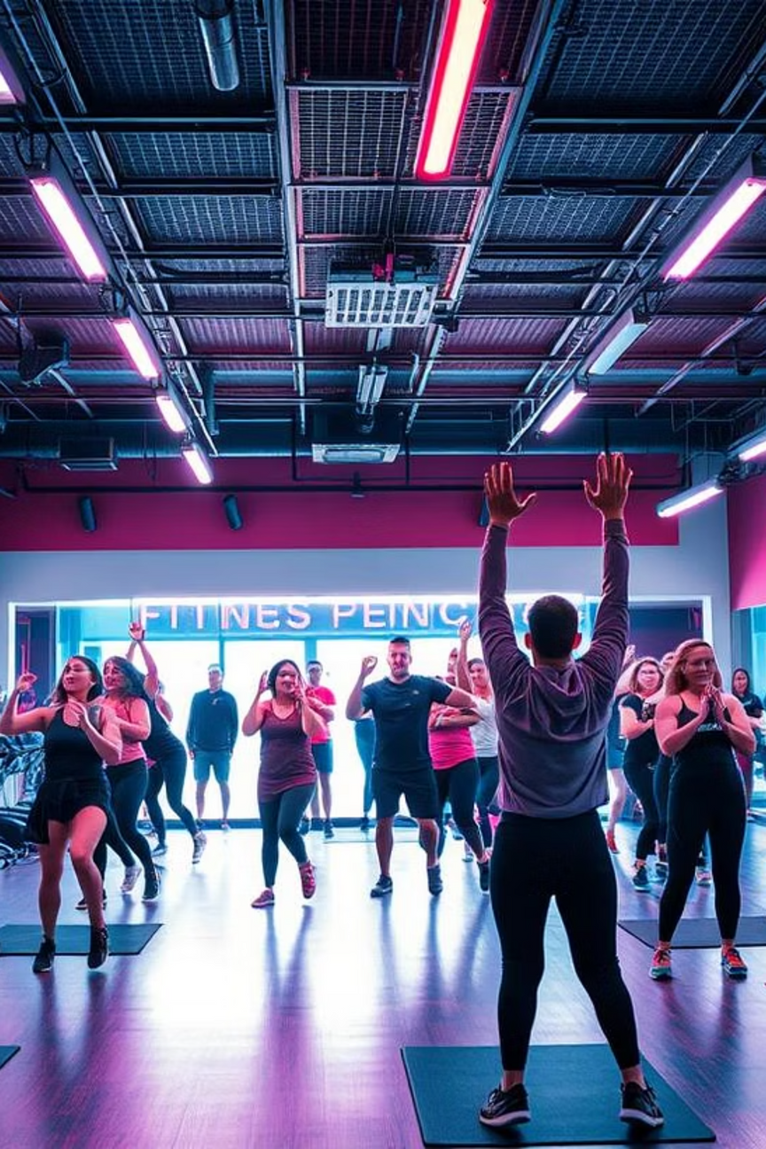

Cult.fit: Redefining India's Fitness Landscape
Founded in 2016 by Mukesh Bansal and Ankit Nagori, Cult.fit (formerly Cure.fit) emerged from a vision to revolutionize India's fitness and wellness industries through a technology-first approach. Leveraging their expertise from Myntra and Flipkart, they embarked on a journey to create an integrated ecosystem for holistic well-being. Currently, cultfit is physically present at 100+ cities with 580+ studios
Notes:
1

Slide 3
Market Dominance and Financial Performance
Cult.fit commands a leading position in India's digital fitness sector, holding approximately 40% market share. As of May 2025, the company boasts over 580+ studios across 100+ cities, showcasing significant expansion and reach.
₹927cr
₹1,000cr
FY24 Revenue
Total FY24 Income
Up ~34% from FY23
Across all verticals
₹-50cr
-3%
FY24 Net Loss
EBITDA Margin
Narrowed significantly
Improved profitability
Notes:
2

Slide 4
SWOT Analysis: Strategic Outlook
Strengths
Weaknesses
Integrated ecosystem: fitness, nutrition, mental health, diagnostics
High operational expenditure from physical centers & kitchens
Inconsistent customer service and trainer quality
Strong digital platform with personalization
Significant urban presence
Overcrowding and diluted quality in some branches
Backed by prominent investors (Zomato, Tata Digital)
High, albeit narrowing, losses (~₹535 Cr)
Opportunities
Threats
Expansion into underserved Tier-2/3 cities and campuses
Intense competition from Decathlon, free content, and apps
Targeting new demographics (Gen-X, older adults)
Regulatory hurdles in telemedicine
Leveraging community initiatives and franchise models
Challenges in customer retention
Market saturation and service quality risks
Notes:
4

Slide 5
Current 4Ps

Slide 6





Current Product Strategy
Cult.fit's product strategy revolves around a comprehensive, multi-service ecosystem designed for holistic well-being. This includes integrated offerings beyond just fitness.
Cult.fit
Mind.fit
Eat.fit
Core fitness programs and studio access.
Mental well-being and mindfulness sessions.
Healthy meal delivery services.
Care.fit
Cult.sport
Diagnostics and healthcare services.
Sports gear and apparel, directly competing with Decathlon.
Notes:
5

Slide 7
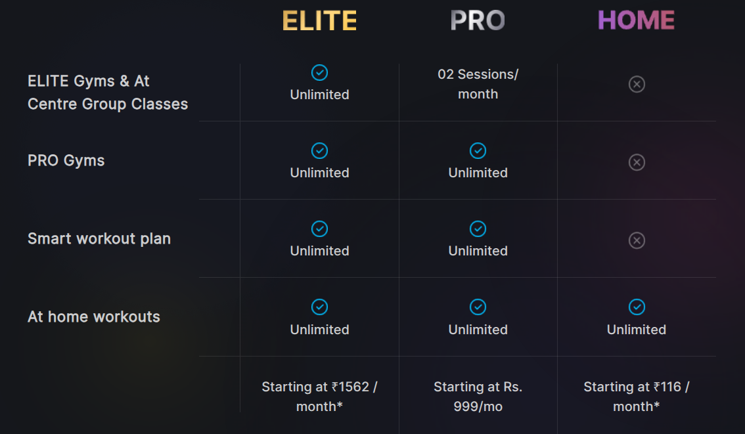
Current Pricing Strategy
Cult.fit employs a flexible, tiered pricing model to cater to diverse customer segments and preferences, offering various access levels.
Hybrid
Combines digital access with physical gym memberships, offering flexibility and comprehensive engagement.
Pay-per-Class
Allows users to attend individual classes without a full membership, catering to casual users or those exploring new formats.
Notes:
6

Slide 8

Current Place Strategy
Cult.fit’s "place" strategy leverages both extensive physical presence and a robust digital platform to ensure broad accessibility across India.
Physical Studios: With approximately 580 studios spread across 100+ cities, Cult.fit utilizes a mix of company-owned and franchise models to maximize reach and market penetration.
Digital Platform: The Cult.fit app and online classes provide seamless access to fitness and wellness content, enabling users to engage from anywhere, at any time.
Notes:
7

Slide 9
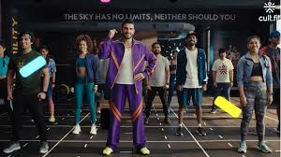
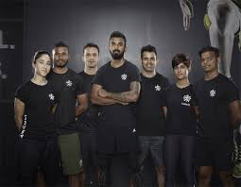

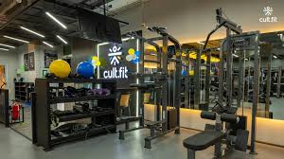
Current Promotion Strategy
Cult.fit's promotion strategy is heavily anchored in digital marketing, coupled with a positioning that balances premium offerings with accessibility.
Digital & Influencer Focus
Extensive digital advertising campaigns across various platforms.
Strategic partnerships with fitness influencers to broaden reach and credibility.
Increased ad spending to approximately ₹188 crores in FY24, indicating aggressive market capture efforts.
Premium-Accessible Positioning
Positioned as a high-quality fitness solution that remains accessible to a broad urban demographic.
For example, annual memberships priced around ₹14,000 balance perceived value with affordability.
Notes:
8

Slide 10
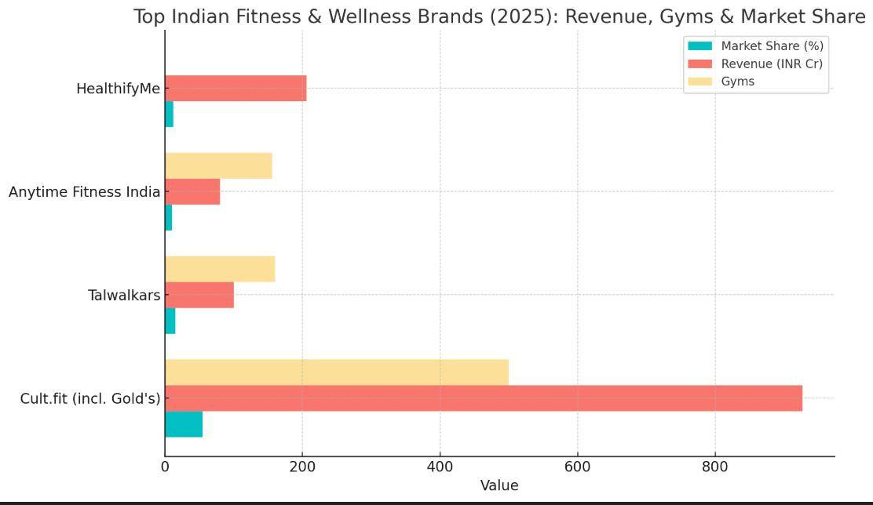
Competitive Landscape in India's Fitness Market
Cult.fit operates within a dynamic competitive landscape, facing both digital platforms and traditional gym chains. Its extensive network of over 580 studios significantly surpasses established competitors.
Market Share (Approx.)
Estimated Revenue (₹ Cr/Year)
Number of Gyms
Notes:
3

Slide 11
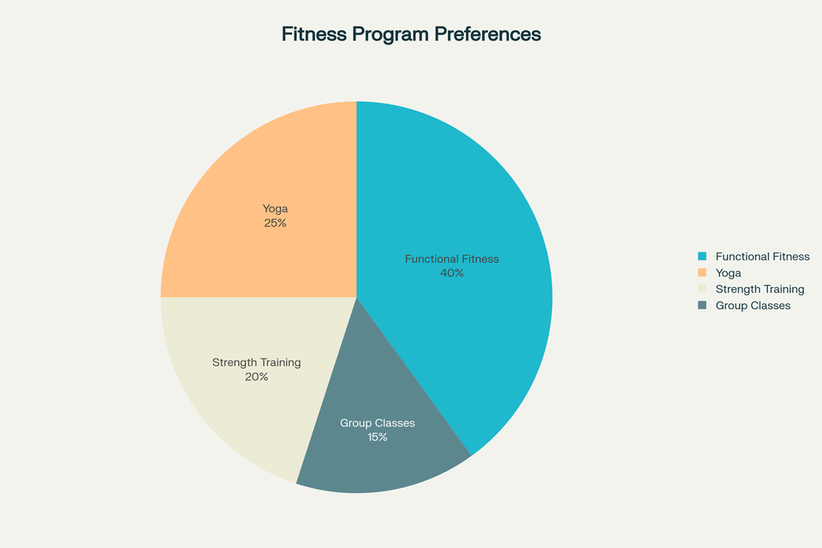
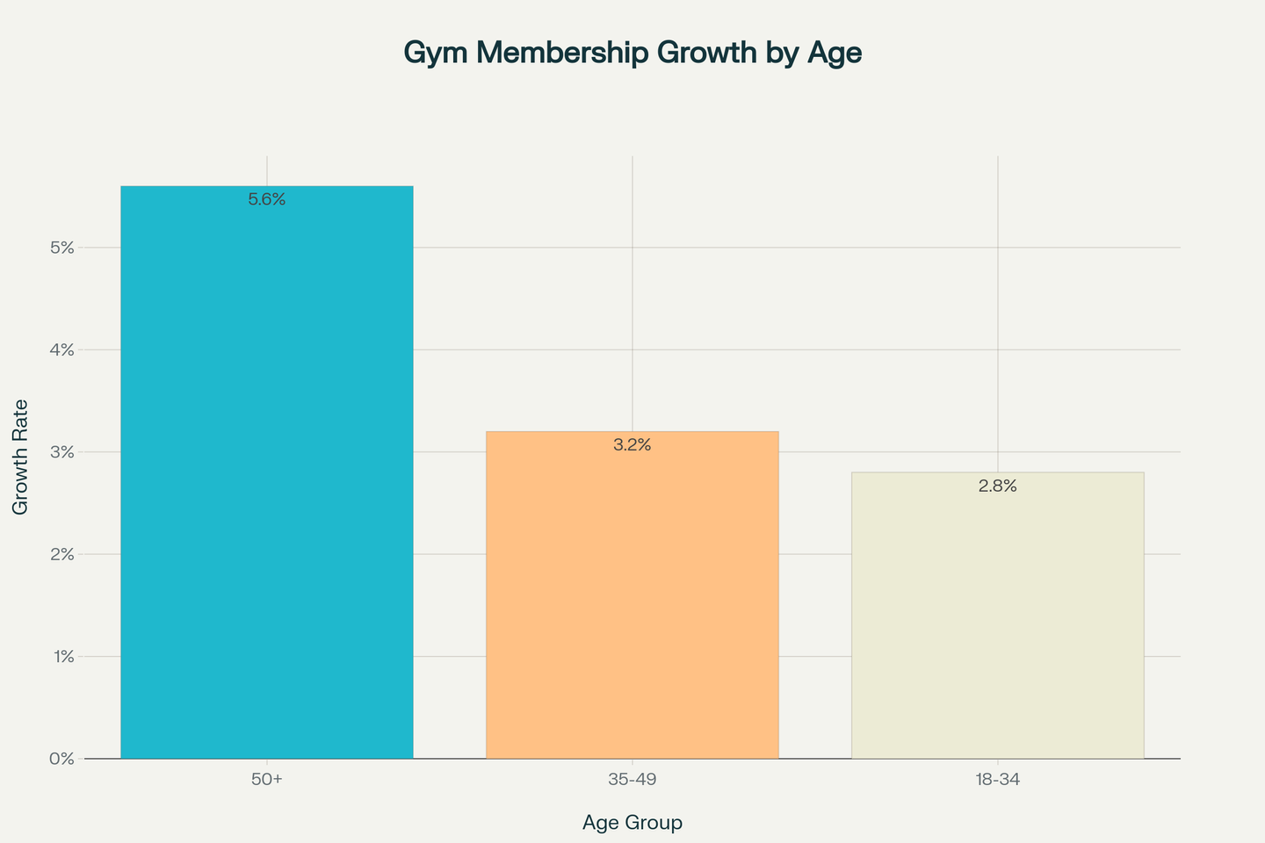
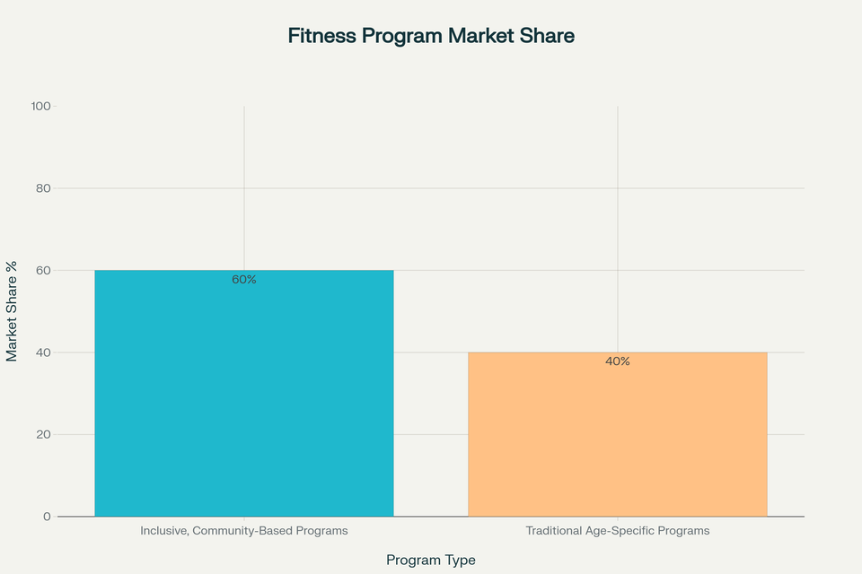
Visualizing the Trends: The Case for Cultfit’s Repositioning
Fitness Program Preferences Among Older Adults
These visualizations provide compelling, data-backed justification for Cultfit’s repositioning toward an all-ages, community-driven fitness brand.

Slide 12

Key Takeaways for Cultfit’s Repositioning
Data-Driven Demand: The surge in older adult memberships and their program preferences support the expansion of inclusive offerings.
Trend Alignment: The “silver revolution” and the popularity of functional fitness for seniors are reshaping the industry.
Market Opportunity: Inclusive, community-based programs are capturing greater market share, signaling a clear opportunity for Cultfit to lead as a first mover in this space.

Slide 13





Why Repositioning?
Evolving Fitness Landscape
Aging Population Gap
Fitness is no longer exclusive to the young or urban elite, expanding to diverse demographics.
India's aging demographic shows low fitness penetration, highlighting an untapped market.
Emerging Hubs
Unifying Opportunity
Tier 2/3 cities and colleges are becoming new centres for fitness activity.
We have the chance to be the first brand to unite all generations and geographies.
The fitness landscape is changing. While young professionals remain important, India’s older generation and youth in smaller cities are ready for a fitness revolution. Cultfit can lead this movement by making fitness accessible, enjoyable, and relevant for all.
Notes:
2

Slide 14
Proposed Repositioning

Slide 15
The New Cultfit Brand Promise
“Fitness for All, All for Fitness”
Inclusive Offerings
Multi-Generational Focus
Community-Driven Core
Diverse activities from walks to intense Zumba.
Programmes designed for grandparents to Gen Z.
Emphasis on togetherness and shared fitness journeys.
Spans gym workouts to dynamic basketball sessions.
Encourages family participation and shared experiences.
Building supportive networks among members.
Caters to all fitness levels and preferences.
Breaking age barriers in fitness engagement.
Fostering a sense of belonging and collective growth.
Our new promise is simple but powerful: Cultfit is for everyone, everywhere. We celebrate diversity in age, activity, and aspiration—making fitness a shared journey.
Notes:
4

Slide 16
Repositioning Strategy: Expanding Product Offerings
To further penetrate the market and cater to evolving consumer needs, Cult.fit proposes innovative product repositioning strategies focused on community and specialized low-impact formats.
5 AM Club
forever.fit
Community-driven early-morning walk/jog groups. Aims to engage health-conscious individuals and older demographics, fostering a sense of belonging and shared fitness goals.
Dedicated to low-impact fitness formats, including chair yoga, senior strength training, and joint-care workouts. This targets an underserved market segment seeking gentle yet effective exercise solutions.
Notes:
9

Slide 17
Repositioned Pricing Strategy
Making Fitness for All, Affordable for All
Personalized Plans
Bundled Wellness
Tailored rates for diverse demographics, including seniors, families, youth, and region-specific pricing for Tier 2/3 cities.
Integrated packages combining fitness, nutrition, and mental well-being for enhanced value.
Flexible Options
Freemium & Trials
Maximise accessibility with off-peak discounts, short-term passes, and pay-per-use models.
Free trial classes and digital content to drive adoption and engagement.
Loyalty & Cross-Selling
Exclusive member discounts on Cultsport gear and Eat.fit meals; rewards for long-term engagement.
Our Goal: Lower barriers, boost retention, and reinforce Cultfit as India’s most inclusive, value-driven fitness community.
Notes:
10

Slide 18

Place Strategy – campus.fit
campus.fit: Dedicated fitness centres located directly on college campuses in Tier 2/3 cities, integrating online and offline experiences.
Comprehensive online and offline integration for workouts, sports, and overall wellness.
Empowering youth as fitness ambassadors to foster widespread community adoption.
Bridging connections to older generations through inclusive family events and open days.
Launch pilot programs in colleges across Tier-2/3 cities to cultivate fitness habits early.
Sponsor inter-college tournaments to build brand affinity among young adults.
Offer special student pricing and subscriptions to drive volume and long-term engagement.
Notes:
6

Slide 19




Promotion Strategy
TV Advertisements
Sports Match Advertising
Digital Campaigns
Community Events
Targeting family audiences, showcasing multi-generational fitness and shared activities.
Featuring authentic stories of real families, seniors, and youth engaging in fitness together.
Organising walkathons, family fitness days, and inter-college challenges to build engagement.
Reaching youth and families during popular sports telecasts like cricket, football, and kabaddi.
Our promotion will be omnichannel. TV and sports ads will build mass awareness, while digital and community events will drive engagement and authenticity. We’ll show real people, real families, and real results.
Notes:
7

Slide 20




Conclusion: The Path Forward for Cultfit
Cult.fit's product strategy revolves around a comprehensive, multi-service ecosystem designed for holistic well-being. This includes integrated offerings beyond just fitness.
New Offerings
Insight Driven Repositioning
forever.fit, 5 AM club, campus.fit - tailored for every generation and communication
Addressing emerging trends and unmet needs across age groups
Tagline
Multi- Channel Outreach
“Fitness for All, All for Fitness” - capturing our community-first vision
TV, sports, digital, and on ground events to reach and unite families nationwide
Cultfit: Poised to become India’s most accessible and welcoming fitness destination.
Notes:
5

Slide 21
References
https://www.indiatoday.in/lifestyle/wellness/story/how-a-silver-revolution-is-taking-place-in-indian-gyms-2750777-2025-07-05
https://timesofindia.indiatimes.com/life-style/health-fitness/weight-loss/top-5-fitness-trends-that-will-redefine-workouts-in-2025/articleshow/116826785.cms
https://corehandf.com/blog/2025-global-fitness-trends-strategies-to-thrive-in-a-changing-industry
https://www.kenresearch.com/industry-reports/india-fitness-market
https://medium.com/design-bootcamp/product-case-study-potential-class-cancellation-reminders-at-cult-fit-9f5532d9cbe3
https://www.infidigit.com/cult-fit-case-study/
https://deccanfounders.com/2025/26/editor_picks/india-gym-industry-and-cult-fitness/
https://canvasbusinessmodel.com/products/cult-fit-swot-analysis
https://prezi.com/p/e_ailzcsejwa/cultfit/
https://www.avyukthealthcare.com/future-of-wellness-industry-in-india/
https://www.mintel.com/press-centre/majority-of-indians-are-seeking-healthier-lifestyles-through-diet-and-exercise/
https://canvasbusinessmodel.com/blogs/competitors/cult-fit-competitive-landscape

Slide 22
ADVERTISEMENT

Slide 23
Thank You

